Slide 1
Lecture 2
Analyzing Risk in the Enterprise

Slide 2
Module 1 Study Guide and Deliverables
Topics: | Lectures 1: Introduction to Enterprise Risk Analytics Lectures 2: Analyzing Risk in the Enterprise
Readings: | Lectures 1 and 2 online content
Discussions: | Module 1 Discussion: Introduce Yourself (non-graded)
Assignments: | Assignment 1: Individual Assignment covering Lecture 1 and Lecture 2.
Assessments: | Quiz 1

Slide 3
Learning Objectives
After you complete this lecture, you will be familiar with the following concepts:
Incorporating uncertainty into a deterministic R model
Using one-way data tables for Monte Carlo simulation
Using R for Monte Carlo simulation
Interpreting the results of the simulation

Slide 4
Outsourcing Decision—Deterministic Spreadsheet Model¹
In this module, we will work with the following simple outsourcing decision model:
Suppose that a manufacturer can produce a part for $125/unit with a fixed cost of $50,000. The alternative is to outsource production to a supplier at a unit cost of $175. Assume that the production volume is fixed and is equal to 1500. All parts should either be manufactured in-house or should be outsourced.
Decision point: The manufacturer wants to know which one is the best decision? Outsourcing or manufacturing in-house?
Adapted from Evans, J. R., Business Analytics: Methods, Models, and Decisions, 2e, 2016, Pearson Education, Inc., pp. 22 and pp. 344-345.

Slide 5
Outsourcing Decision—Deterministic Spreadsheet Model¹
We will first build an R model for the outsourcing decision.
Individual Exercise:
Before you read any further, please try to build the R model on your own.
Figure 2.1 presents the resulting model:

Slide 6
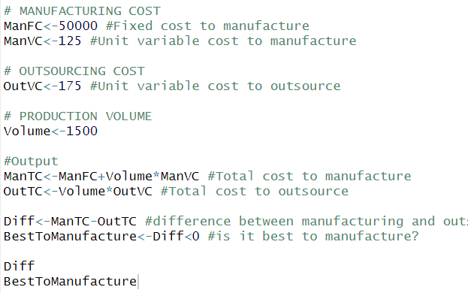

Outsourcing Decision—Deterministic Spreadsheet Model¹
Figure 2.1

Slide 7
Outsourcing Decision—Deterministic Spreadsheet Model¹
The inputs for ManVC, ManFC, OutVC and Volume, namely, the fixed cost, unit variable cost, unit cost of outsourcing and the production volume are given in the description of the problem. We calculate the total manufacturing cost, ManTC as follows:
Total manufacturing cost = Fixed cost + unit variable cost × production volume
ManTC=ManFC + ManVC × Volume
Thus, ManTC=$50,000 + $125 × 1500=$237,500.
We calculate the total outsourcing cost in cell B17 as follows:
Total outsourcing cost = unit cost (outsourced from supplier) × production volume (outsourced from supplier)
Cell OutTC=OutVC × Volume
Thus, OutTC= $175 × 1500 = $262,500.

Slide 8
Outsourcing Decision—Deterministic Spreadsheet Model¹
In making the decision, what is important for us is the cost difference. Therefore, “Diff” calculates the difference between the total manufacturing cost and the total outsourcing cost; i.e, ManTC-OutTC. If this difference is smaller than zero, then this means that manufacturing in-house is less costly and the manufacturer should choose to manufacture in-house. Otherwise, the manufacturer should choose to outsource. We found that this difference is $237,500 – $262,500 = –$25,000. Thus, the best decision in this case turns out to be manufacture in-house. Our model communicates the best decision to us in “BestToManufacture”, which returns TRUE when ManTC is lower than OutTC and FALSE otherwise:
BestToManufacture = Diff<0

Slide 9
Outsourcing Decision—Deterministic Spreadsheet Model¹
We are done with developing the spreadsheet model for our problem. One of the major assumptions that we made is that all inputs are known with certainty. However, as we discussed in Lecture 1, uncertainty is inevitable and it may impact our decisions to a great extent. Now, assume that the production volume is uncertain in our model. This uncertainty of the production volume usually stems from the uncertainty in the demand process; therefore we will use the terms "production volume" and "demand" interchangeably in this module. In the next section, we will learn how to incorporate this uncertainty into our spreadsheet model.

Slide 10
Incorporating Uncertainty into the Model
The assumption that the demand and hence the production volume is uncertain is quite reasonable and indeed is a representation of a real-life situation. No one has a way of knowing the actual value of the demand; we can only make forecasts.
We model our uncertain variable – the demand (production volume) – as a random variable having a probability distribution. In statistics, a "random variable is any variable whose value cannot be predicted or set with certainty."². A probability distribution characterizes all values that a random variable may take. We will learn more about probability distributions in Lecture 3.
Individual Exercise:
Topics related to the notion of distribution are covered in Unit 3 of the laboratory “Statistics with Applications in Management”. Please review the corresponding module.

Slide 11
Incorporating Uncertainty into the Model
One of the most widely used probability distributions is the normal distribution. "Assume that the demand is normally distributed with a mean of 1000 and a standard deviation of 100."³ How do we come up with the numbers 1000 and 100? It will be clear in Lecture 5. For now, just follow with me.
Question: How do we generate random values of demand in R? Answer: We will use the R function rnorm(n, mean, sd) to generate random values from the normal distribution.
The rnorm function generates “n” random variables, normally distributed with mean “mean” and standard deviation “sd”. Right now, we’re going to content ourselves with 15 trials, so we’ll use rnorm(15,1000,100). Note it would also be good syntax to write rnorm(n=15,mean=1000,sd=100).

Slide 12


Incorporating Uncertainty into the Model
Figure 2.3
If we don’t want our result to return fractional values, we can also apply the round() function, as follows. Here I use the %>% operator from the magrittr library. It would work just as well to type round(rnorm(15,1000,100)), but %>% makes for more readable code.
Figure 2.4
Since we are generating random numbers, you should expect to get a different result than what you observe here, and indeed a different result each time you run this line of code.

Slide 13
Incorporating Uncertainty into the Model
Since the demand is random in real life, each time we element of our rnorm vector gives us a different possible representation of the demand we might experience.
Question: So, how do we make our final decision? Answer: We randomly generate the production volume and the associated decision several times and look at the distribution of the output (i.e, best decision) that we get.
For instance, if we press generate 200 different demands, and record the best decision (either manufacture or outsource) each time, and out of 200 scenarios, if we get 150 outsource and 50 manufacture as the best decision, then this suggests that the best decision under demand uncertainty is to outsource. This is what Monte Carlo simulation is doing exactly!
As you recall from Lecture 1, Monte Carlo (MC) simulation is the process of generating random values for uncertain inputs in a model, computing the output variables of interest, and then repeating this process for many trials to understand the distribution of the output results.⁴ We will see how to implement MC simulation below.

Slide 14

Scalars and Vectors in R
For our purposes, a scalar is simply a number and a vector is a list of numbers with a set length.
Fortunately for us, when you perform a function using a scalar (such as ManVC) and a vector of length n such as volume in our new model, R will create a new vector of length n where each element is the result of the function called on the scalar and each element of the vector.
When you perform a function using two vectors if equal length n, R will create a new vector of length n where each element is the function called on those corresponding elements. This may sound confusing, but it’s easy to see what’s going on in practice. Observe the examples in Figure 2.5:
(Note we create vectors manually by using the c() function):
Figure 2.5
Here we first added the number 1 to the vector (1,2,3) and it returned the result of adding one to each element (1+1,2+1,3+1) Below that, we added the vector (1,2,3) to (10,20,30) and it returned the result of adding each element to the corresponding element in the next vector (1+10,20+2,30+3). We will use this to combine certain elements of our model (scalars) with uncertain elements (vectors).

Slide 15


Creating a Model
We’ve already created a deterministic model for our outsourcing problem. We need only replace our determined (scalar) volume with an uncertain (vector) equivalent. Continuing with the example above, let’s assume our demand (and thus, production volume) is normally distributed with mean 1000 and standard deviation 100, and for the purposes of demonstration, let’s assume we only want to run 15 trials. We first add lines to define the number of trials, and the parameters of our volume distribution:
Figure 2.6
Figure 2.7
We then replace the old scalar production volume with a new vector of production volumes, using the parameters we defined above:
Figure 2.8

Slide 16

Creating a Model
Because of R’s vector/scalar handling, our old formulas will still work perfectly. We may, however, wish to display our results in a logical manner. Here the cbind function* is called to create a matrix displaying our randomly generated volume, the difference between manufacturing and outsourcing, and whether it’s best to manufacture in one table. We use the as.data.frame function so that the resulting output will be nicely formatted. The full code and results are displayed in Figure 2.10.
Figure 2.9
*We could call cbind just once here, but that would coerce BestToManufacture into an integer. In order to keep it as a Boolean, we must first create the dataframe.

Slide 17
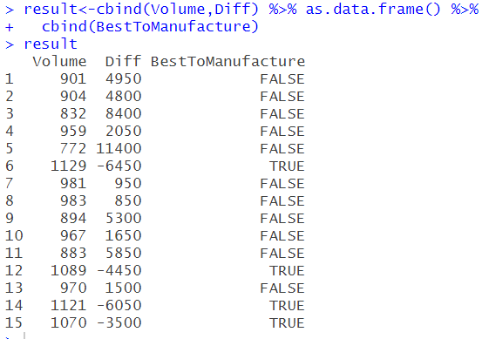
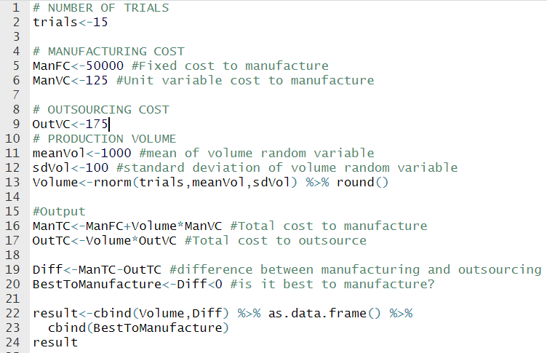
Creating a Model
Figure 2.10

Slide 18
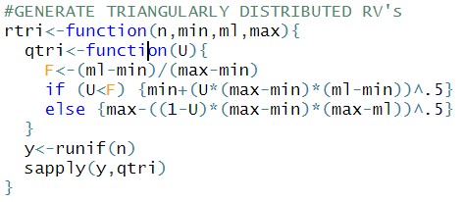
Creating Another Model
Now let’s further assume that the cost to purchase from a supplier is also uncertain. All we know is that the minimum it may cost is $160, the maximum is $200, and the most likely value is $175. We’ll use the triangular distribution* to model this behavior. Determining uncertain inputs and which distributions to use is the most difficult part of simulation modeling; for now we’ll accept the distributions as outlined by the problem.
Figure 2.11
*You are familiar with the normal distribution but you are not familiar with the triangular distribution yet. This is completely fine. To comprehend this section, you do not need to know the details about the triangular distribution. It will be covered in Lecture 3. Base R does not contain a function to randomly generate variables following a triangular distribution, so we’re compelled to define our own. The code is reproduced in Figure 2.11.

Slide 19
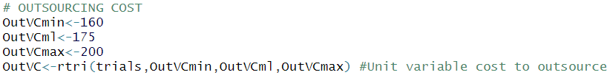
Creating Another Model
Instead of running 15 trials, we’ll run 10000. We won’t be able to neatly look at them all as we did before, but we will be able to make stronger inferences and summarize the results with numbers and graphics. The tradeoff is that a larger number of trials requires more computational power. We will see in lecture 4 how to determine how many trials to run.
As with rnorm, we tell our rtri function the number of trials we want and the parameters we’re using (see figure 2.12).
We’ll need the e1071 package and the tidyverse package to generate some statistics and images for our model. The finished model is reproduced in figure 2.13.
Figure 2.12

Slide 20
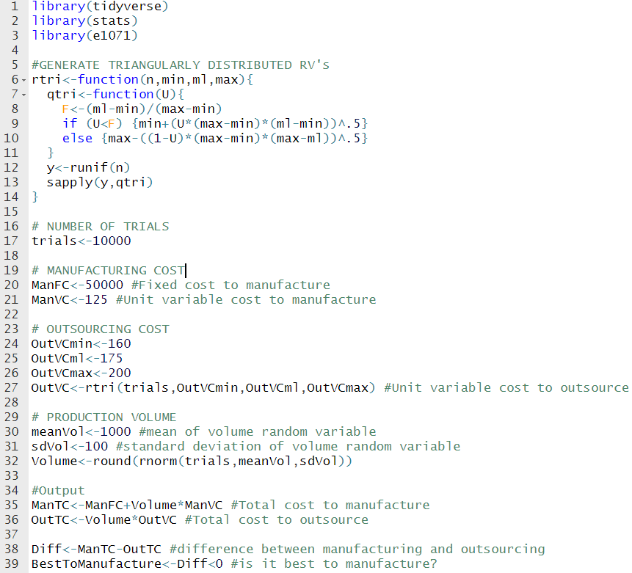
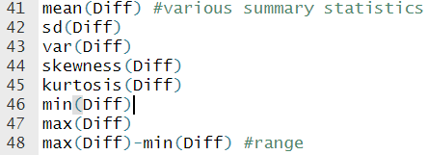
Creating Another Model
Figure 2.14
Figure 2.13

Slide 21
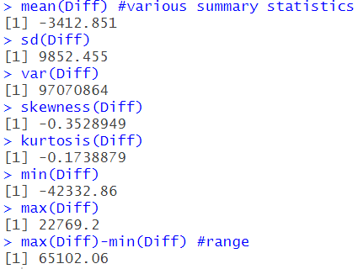
Creating Another Model
With a little more work, we can determine several key statistics about our data (see Figure 2.14. We find the following results, which are explained in further detail below:
Figure 2.15

Slide 22
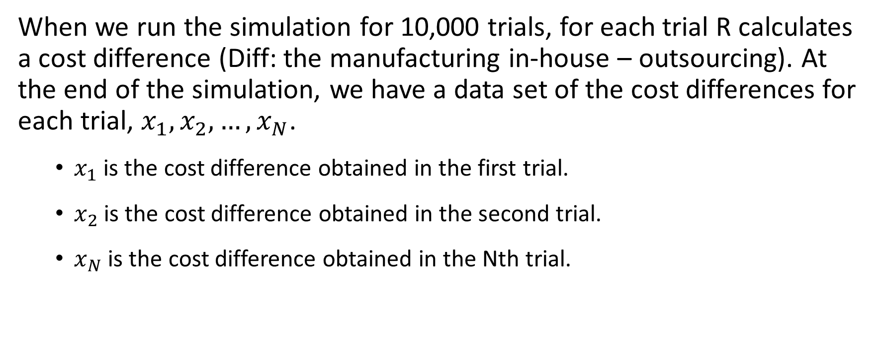
Interpreting our Model
When we run the simulation for 10,000 trials, for each trial R calculates a cost difference (Diff: the manufacturing in-house – outsourcing). At the end of the simulation, we have a data set of the cost differences for each trial, $x_{1},x_{2},…,x_{N}$.
$x_{1}$ is the cost difference obtained in the first trial.
$x_{2}$ is the cost difference obtained in the second trial.
$x_{N}$ is the cost difference obtained in the Nth trial.

Slide 23
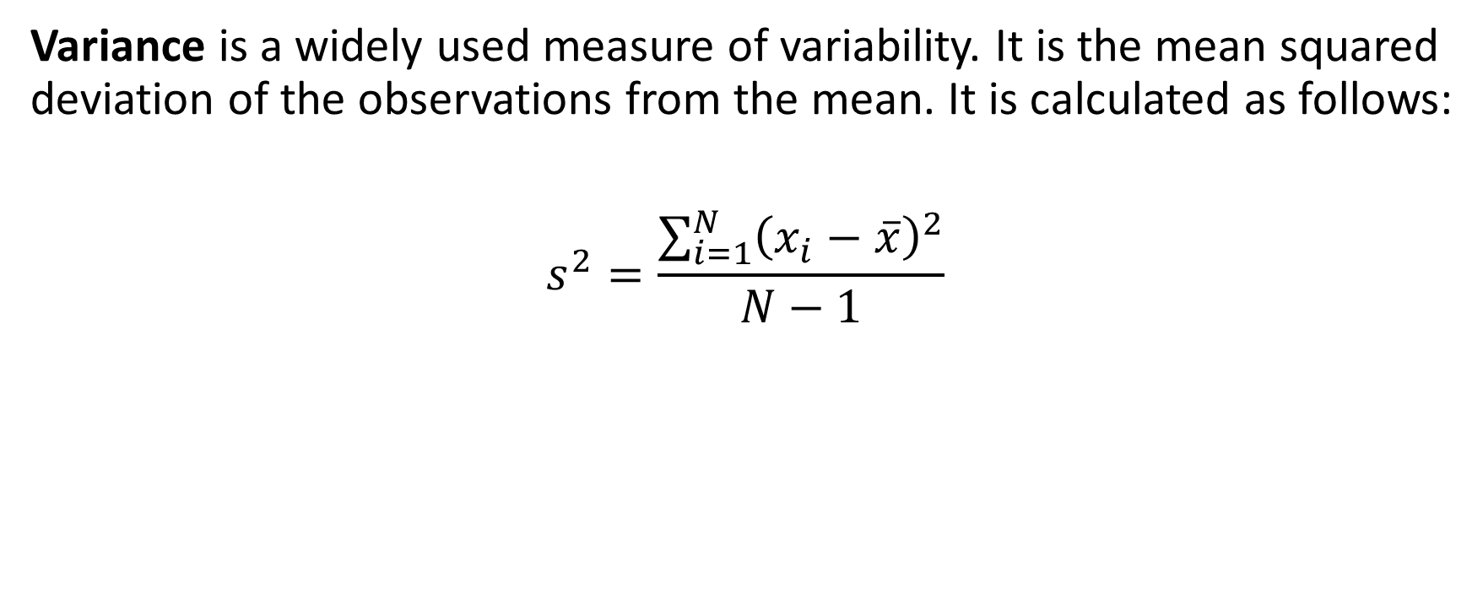
Interpreting Our Model
Variance is a widely used measure of variability. It is the mean squared deviation of the observations from the mean. It is calculated as follows:
$$s^{2}=\frac{\sum_{i=1}^{N}{{\left(x_{i}−\overline{x}\right)}^{2}}}{N−1}$$

Slide 24
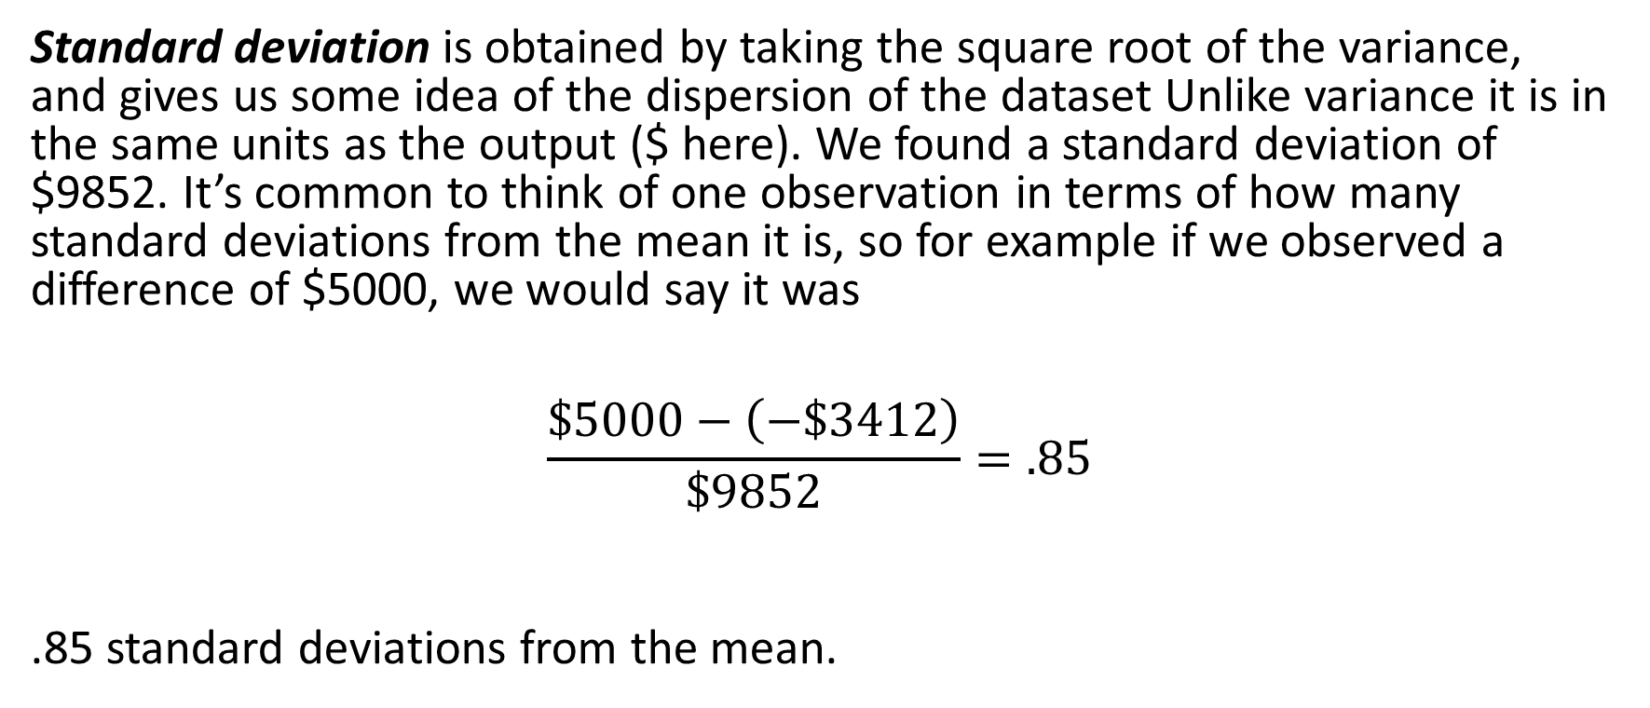
Interpreting Our Model
Standard deviation is obtained by taking the square root of the variance, and gives us some idea of the dispersion of the dataset Unlike variance it is in the same units as the output ($ here). We found a standard deviation of $9852. It’s common to think of one observation in terms of how many standard deviations from the mean it is, so for example if we observed a difference of $5000, we would say it was
$$\frac{\$5000−\left(−\$3412\right)}{\$9852}=.85$$
.85 standard deviations from the mean.

Slide 25
Interpreting Our Model
Skewness is a measure of asymmetry of a probability distribution. A negative skewness implies that the distribution is left-skewed and a positive skewness implies that the distribution is right-skewed.
Our Skewness is equal to –0.35, which suggest that the frequency distribution of the cost difference is left-skewed. This can be easily observed from the histogram in Figure 2.19.

Slide 26
Interpreting Our Model
Kurtosis measures whether a distribution has
A narrow peak and long tails (positive), or
A wider peak and short tails (negative)
relative to a distribution with similar variance.
Kurtosis is equal to –0.17, which suggest that the frequency distribution of the cost difference has short tails.

Slide 27
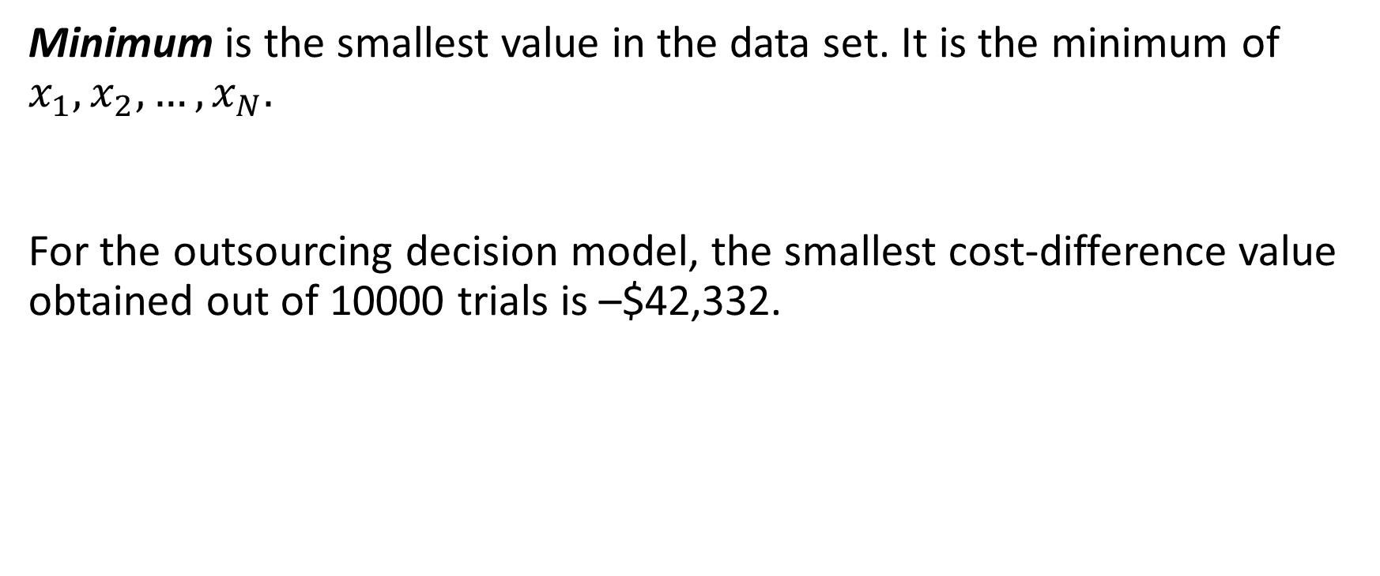
Interpreting Our Model
Minimum is the smallest value in the data set. It is the minimum of $x_{1},x_{2},…,x_{N}.$
For the outsourcing decision model, the smallest cost-difference value obtained out of 10000 trials is –$42,332.

Slide 28
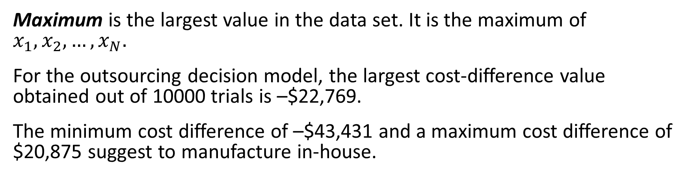
Interpreting Our Model
Maximum is the largest value in the data set. It is the maximum of $x_{1},x_{2},…,x_{N}.$
For the outsourcing decision model, the largest cost-difference value obtained out of 10000 trials is –$22,769.
The minimum cost difference of –$43,431 and a maximum cost difference of $20,875 suggest to manufacture in-house.
Note: Do not interpret the minimum and the maximum as the worst case; as the number of iterations increases, they will typically continue to spread. However, these are the estimates of the best- and worst-case results that can be expected.

Slide 29
Interpreting Our Model
Range is the difference between the maximum value and the minimum value of a data set.
For the outsourcing decision model, the range is $22,769 – (–$42,332) = $65,012.

Slide 30

Interpreting Our Model
We can quickly generate a 5-number summary using the summary function on Diff. This will show us the minimum, 25th percentile, median, 75th percentile, and maximum of our dataset.
Figure 2.16

Slide 31
Interpreting Our Model
If we wanted to know how often it was better to manufacture, we can see how often the Diff variable, that is the cost to manufacture minus the cost to outsource is less than 0 by seeing how often the BestToManufacture variable is TRUE. Booleans, when converted to integers, are coerced to 1 for TRUE and 0 for FALSE, so we need only sum up the number of TRUES and divide by the number of trials. We observe about 60% of the time, manufacturing is the correct decision.
Figure 2.17
Individual exercise:
How often would the company save at least $1000 by manufacturing as opposed to outsourcing?

Slide 32
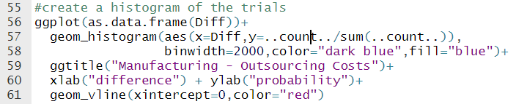
Graphing Our Model
Let’s use a histogram to graph our results. The code I’m using is in Figure 2.18, and requires ggplot from the tidyverse library. The resulting graph is in Figure 2.19
We use the as.data.frame() function to coerce Diff into a form ggplot can read.
..count.. is a special element of ggplot which counts the number of observations within a bin, allowing us to get the probability density along the y-axis.
binwidth controls the width of a horizontal bar on the x-axis (in this case 2000).
If we wanted to control the number of bins instead, we could use bins instead.
ggtitle, xlab, and ylab all allow us to control the labels and the title.
Finally, the geom_vline call inserts a vertical line at x=0, where outsourcing and manufacturing break even.
Figure 2.18

Slide 33
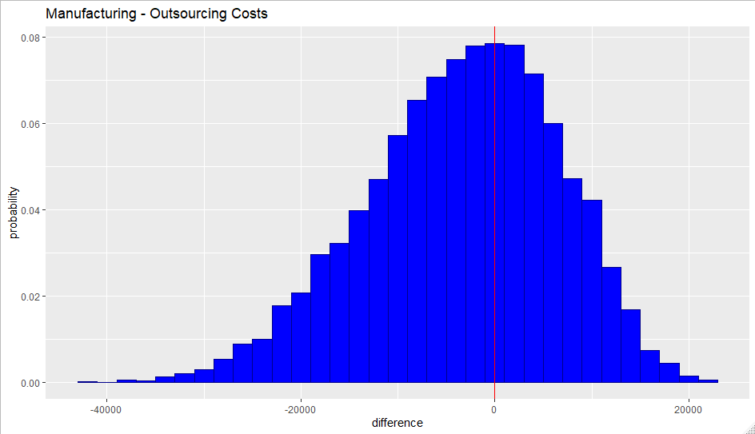
Graphing Our Model
Figure 2.19

Slide 34
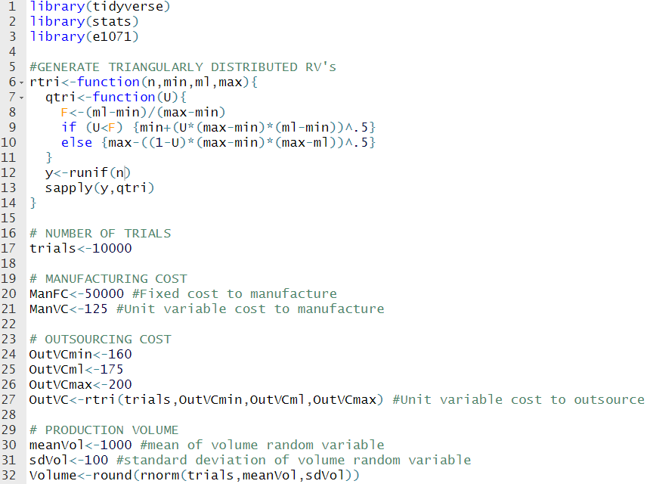
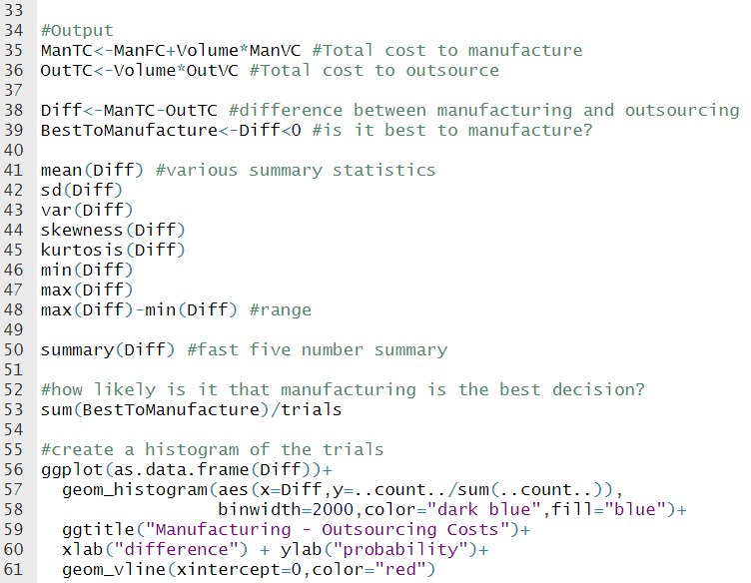
Code for Model 2:
Figure 2.20

Slide 35
Lecture 2 Footnotes
¹ Evans, J. R., Business Analytics: Methods, Models, and Decisions, 2e, 2016, Pearson Education, Inc., pp. 344-345.
² Ragsdale, C. T., Spreadsheet Modeling & Decision Analysis: A Practical Introduction to Business Analytics, 7e, Cengage Learning, p. 619. ³ Evans, J. R., Business Analytics: Methods, Models, and Decisions, 2e, 2016, Pearson Education, Inc., p. 379. ⁴ Evans, J. R., Business Analytics: Methods, Models, and Decisions, 2e, 2016, Pearson Education, Inc., p. 379.
⁵ Evans, J. R., Business Analytics: Methods, Models, and Decisions, 2e, 2016, Pearson Education, Inc., p. 364. ⁶ Evans, J. R., Business Analytics: Methods, Models, and Decisions, 2e, 2016, Pearson Education, Inc., p. 364.

Slide 36
Lecture 2 References
Evans, J. R., Business Analytics: Methods, Models, and Decisions, 2e, 2016, Pearson Education, Inc.
Ragsdale, C. T., Spreadsheet Modeling & Decision Analysis: A Practical Introduction to Business Analytics, 7e, Cengage Learning.

Slide 37
Lecture 2 Summary Questions
How do we model an uncertain variable in R?
What is a “random variable” and what is a “probability distribution”?
What is the R function used to generate random values from the normal distribution?

Slide 38
Lectures 1 & 2 Individual Exercise
The problems in the individual exercise is designed for you to practice what you have learnt in Lecture 1 and Lecture 2. Do not submit anything to your facilitator and/or instructor.
Question: A mortgage lender wants to see how many applications they can process in 20 days. A mortgage application should be processed through six departments (department A to department F) before it is finalized. The number of applications received for each day (demand), and the number of applications processed per day for each department are defined as random variables that can take any integer value between 1 and 6 (like rolling a dice). Initially, all departments have 4 applications in their inbox at the beginning of day 1.
Create a mathematical model of this problem in R.
You can use runif and round formulas to generate values for the demand and the production. Be careful here!
What is the total number of completed applications at the end of the day 20?
Does that number changes as you update/recalculate the random variables?
What is the expected number of completed applications per day?

Slide 39
